Slide 1
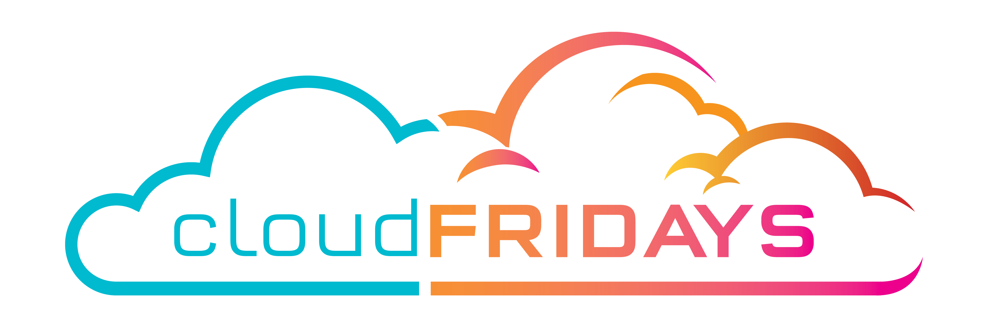

Session title
Subtitle
Speaker Name(s)
Speaker Details(s)

Slide 2




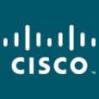

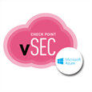

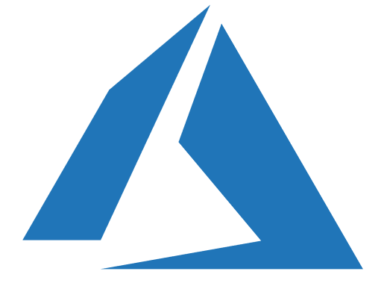




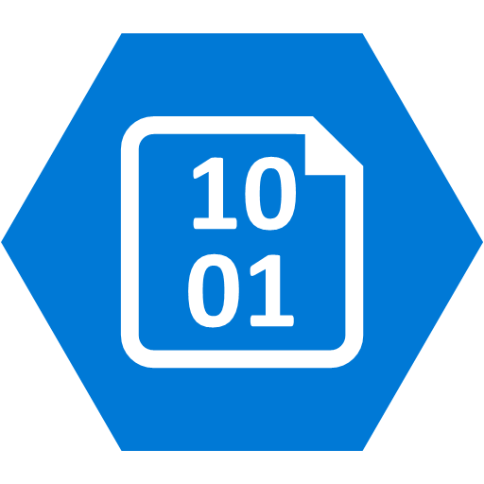

Hybrid Cloud Infrastructure
CHALLENGES
Limited experience and toolsets for securing hybrid architecture and Platform as a Service
Critical Risks - Privilege management and security hygiene critical for cloud workloads
MICROSOFT’S APPROACH
Cross-Platform and Cross-Cloud – security capabilities to enable visibility and control
Deep Azure Defenses – Integrated with platform to secure Azure workloads, assess compliance
On Premises security investments to modernize security and leverage cloud learnings + technology
Marketplace – Integrate existing capabilities and skills
Privilege Management – Protect against high impact attacks against privileged accounts
Secure Development Lifecycle (SDL) – Securing applications and PaaS workloads
Hybrid Cloud Infrastructure
On Premises Datacenter(s)
3rd party IaaS
Microsoft Azure
Azure Security Center – Cross Platform Threat Protection and Threat Detection
Configuration Hygiene
Just in Time VM Access
NGFW
Security Appliances
Adaptive App Control
Extranet
Edge DLP
Azure Policy
SSL Proxy
IPS
Azure Key Vault
Express Route
Azure WAF
Windows Server 2016 Security
Window 10 + Just Enough Admin, Hyper-V Containers, Nano server, and more…
Azure Antimalware
Application & Network Security Groups
Shielded VMs
VMs
Intranet Servers
Backup & Site Recovery
Azure Stack
Privileged Access Workstations (PAWs)
Disk & Storage Encryption
Confidential Computing
Included with Azure (VMs/etc.)
Premium Security Feature
DDoS attack Mitigation+Monitor
Security Development Lifecycle (SDL)
Compliance Manager
Notes:
Key Takeaway: Microsoft helps you manage and secure a hybrid infrastructure that spans across Azure, on-premises, and 3rd party clouds like Amazon Web Services (AWS)

Slide 3








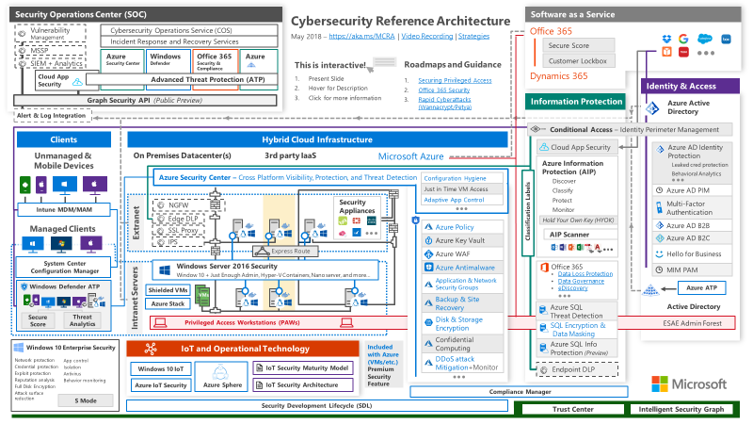
Software as a Service (SaaS)
CHALLENGES
Governance, Risk, and Compliance challenges of sprawling SaaS estate and unsanctioned shadow IT
Security Operations Center (SOC) requires visibility into SaaS activities and threats
MICROSOFT’S APPROACH
Platform Security – Deep investments in physical security, Red/Blue Teams, encryption, privileged access, & more
Software as a Service
Office 365
Dynamics 365
Manage Shadow IT Risk – CAS enables you to discover, assess, approve, and manage SaaS (via API +Proxy)
SOC Enablement – Microsoft Cloud App Security (CAS) provides anomaly detection, alerting, and SIEM integration
Cloud App Security
Office 365
Office 365 ATP provides advanced security (sandbox detonation, etc.) for email, SharePoint, Teams, and more
Threat Intelligence provides analytics on attack trends for your tenant and your industry
Advanced Threat Protection (ATP)
Office 365
Security & Compliance
Office 365 Guidance – Security Roadmap + Secure Score recommendations guide you through security journey
Roadmaps and Guidance
Securing Privileged Access
Office 365 Security
Rapid Cyberattacks(Wannacrypt/Petya)
Secure Score
Compliance – GDPR and NIST compliance visibility on Office 365 and Dynamics 365 with Compliance Manager
Compliance Manager
Information Protection – CAS integration with Azure Information Protection to discover + protect data
Customer Lockbox to provide final control of access to data by Microsoft personnel
Customer Lockbox
Notes:
Key Takeaway: Microsoft has invested in secure and compliant SaaS services as well as helping you secure 3rd party Software as a Service (SaaS) with cloud app security broker technologies.

Slide 4
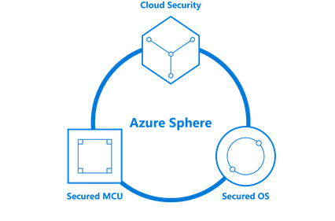
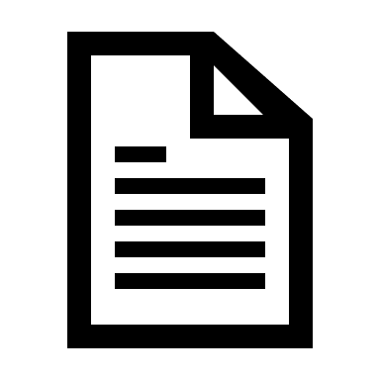
IoT and Operational Technology
Significant potential value and security/privacy risks
CHALLENGES
End to end approach required for effective IoT security
Large brownfield of existing devices to manage and secure
~9 Billion new microcontroller devices shipping every year for a wide range of IoT devices from low power crop sensors to powerful devices for point of sale (POS)
MICROSOFT’S APPROACH
Secure a wide range of HW platforms in partnership with silicon partners, OEMs, and suppliers (for Edge and IoT devices). Enable both brownfield and greenfield devices to achieve higher levels of security
Support wide range of platforms including Linux, Windows and RTOS with open source SDKs in many languages
Provide security monitoring, alerts and mitigation from the device to the cloud application using Azure Security Center for a wide range of IoT devices and solutions
Provide best in class security from silicon to cloud for MCUs with Azure Sphere
Provide guidance, best practices, & tools for secure design + evaluation (threat modeling, SDL, pen testing, etc.)
Contribute to and drive security standards across the IoT infrastructure (DICE, SMM and many more)
IoT and Operational Technology
Windows 10 IoT
Azure Sphere
IoT Security Maturity Model
IoT Security Solutions
IoT Security Architecture
Security Development Lifecycle (SDL)
Notes:
Key Takeaway: Microsoft is investing heavily to secure the IoT ecosystem as it (and the risk associated with it) grows
Organizations are embracing the opportunity to reimagine and fundamentally transform their businesses using Internet of Things (IoT) technology. Microsoft is investing in many technologies to manage and secure this ecosystem including an end-to-end solution (called Azure Sphere) designed to provide highly-secured, Internet-connected microcontroller (MCU) devices.
https://azure.microsoft.com/en-us/blog/introducing-microsoft-azure-sphere-secure-and-power-the-intelligent-edge/

Slide 5


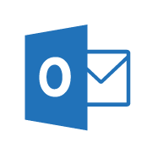
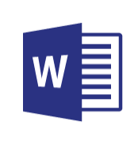
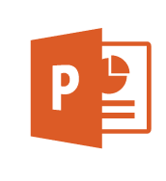
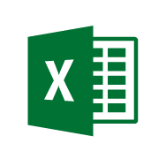
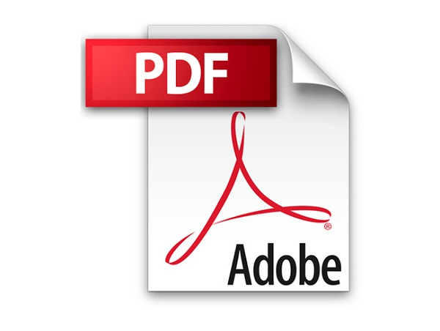

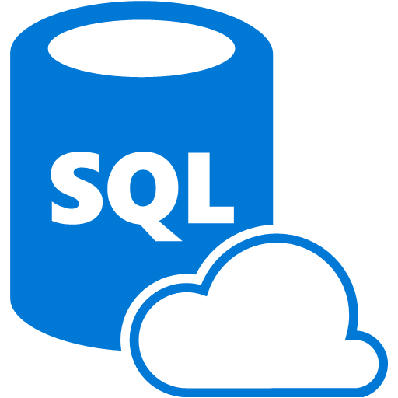
Information Protection
Information Protection
CHALLENGES
Information Protection and Data Governance Strategy
Label, track, and show data loss or manipulation of a file.
Implement corporate policies to protect different levels of sensitive data
Protecting sensitive information
Challenging to discover and classify data across mobile devices, SaaS, cloud infrastructure, and on-premises
Need full lifecycle data protection for identified data
MICROSOFT’S APPROACH
Broad Coverage for structured and unstructured data across formats, cloud, & devices
Full Information Lifecycle
DISCOVER existing and newly created sensitive data
CLASSIFY automatically + user control (based on policy), integration with DLP
PROTECT the data itself, not just storage or network locations
MONITOR and revocation capabilities for security and compliance
Edge DLP
Conditional Access
Cloud App Security
Office 365 DLP
Classification Labels
Azure Information Protection (AIP)
Discover
Classify
Protect
Monitor
Hold Your Own Key (HYOK)
AIP Scanner
Azure SQL
Threat Detection
SQL Encryption & Data Masking
Azure SQL Info Protection
Endpoint DLP
Notes:
Key Takeaway: Microsoft is focused on providing strong data protection with an emphasis on persistently protecting the data anywhere it goes
This contrasts with the common industry approach that relies solely on controls for devices/storage/network that are unable to protect the data created/copied outside the enterprise
More information on our strategies and technologies is in the CISO workshop Module 5

